Slide 1
SolarWinds Hack
Neutral Background of Events - Group 3

Slide 2
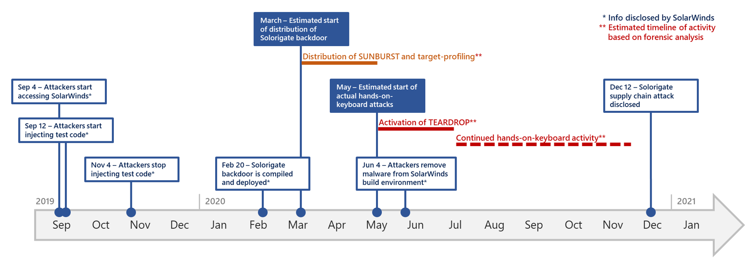
Brief Summary of Event
September 2019: Russian Foreign Intelligence Service injects malicious test code into Orion, Solarwinds’ network management system
February 2020: Threat actor injects code into software update files
March 26th, 2020: Solarwinds releases software update with trojanized code
Around 18,000 customers compromised
Most affected were US gov’t agencies and other “high-profile” companies
Figure 1: Visual timeline of events (Microsoft)
Notes:
Sources:
https://www.gao.gov/blog/solarwinds-cyberattack-demands-significant-federal-and-private-sector-response-infographic
https://www.techtarget.com/whatis/feature/SolarWinds-hack-explained-Everything-you-need-to-know

Slide 3

What type of risk event was the Solarwinds attack?
Gray Rhino - Known Unknown
It was a highly predictable and high-impact cybersecurity risk that seemed to be largely underestimated of its likelihood until it had caused significant damage.

Slide 4
Enterprise Risk Involved
Asset Risks
Compromised files: Possibility of files and systems being damaged/destroyed
Customer protection: Exposed stakeholders to data theft, espionage, and further cyberattacks
Missing protective safeguards: SolarWinds' software and update process, which lacked adequate security safeguards
Business Risks
Supply Chain: Attackers exploited Orion’s software update process to access the networks of thousands of organizations globally.
Financial Risks
On average, companies lost 11% of annual revenue. American companies (14%), Singaporean companies at 9.1%, UK companies at 8.6%
Insurance companies paid up to $90 million for incident response
Safety Risks
Impersonation: Hackers could use compromised personal information to impersonate employees and gain unauthorized access
Notes:
Sources:
https://www.cyberark.com/resources/threat-research/the-anatomy-of-the-solarwinds-attack-chain
https://www.aquasec.com/cloud-native-academy/supply-chain-security/solarwinds-attack/#:~:text=In%20addition%20to%20the%20direct,to%20protect%20against%20such%20attacks.
https://www.fortinet.com/resources/cyberglossary/solarwinds-cyber-attack
https://www.bitsight.com/blog/the-financial-impact-of-solarwinds-a-cyber-catastrophe-but-insurance-disaster-avoided

Slide 5
Enterprise Risk Involved (cont.)
Information Risks
Data loss/damage: Since there was unauthorized access to both Solarwinds and customer networks, there could be data loss and/or damage caused by threat actors.
Program/Project Risks
Resource reallocation: Solarwinds had to focus on diverting resources to this effort in order to remediate the attack. Efforts on other projects may have had to be halted.
External Risks
Impact on Customers: Breach of Solarwinds affects customers too since their systems are connected to Orion. Can cause different types of risks on individual organizations.

Slide 6
Quantifiable Data Regarding Any Losses.
More than 18,000 companies were affected in the Solarwinds attack
9 U.S. Federal Agencies were affected
Impacted companies include Microsoft, Cisco, Deloitte
Insurance companies paid up to $90 million for incident response
Since the breach commenced, 15 months passed until public disclosure

Slide 7
Importance of Event
The SolarWinds attack is often cited as a significant cyber incident due to its scale, complexity, and impact on cybersecurity. By exploiting vulnerabilities in the software supply chain, the attack demonstrated how IT service providers can be compromised, leading to a widespread breach that affected thousands of organizations, including government agencies.
It underscores vulnerabilities in modern cybersecurity, particularly within supply chain security, and serves as a reminder for governments, organizations, and industries about the rising complexity of cyberattacks and their potential effects on operations and public trust.
Consequences:
Supply chain vulnerability
Global reach of the hack
U.S. Government breached
Loss of public trust

